Slide 1

Team Details
Team Name: Pixel Perfect
Team Leader Name: Ganesh V
Problem Title: ONLINE PARKING SLOT RESERVATION SYSTEM USING ML, RFID AND AR

Slide 2

PROTYPE DETAILED EXPLANATION
Proximity-Based Parking Slot Display
1.User Location Detection:
Geolocation API Integration: Utilize browser-based geolocation APIs (such as the Geolocation API provided by HTML5) to detect the user's current location when they visit the website.
Permission Request: Prompt users for permission to access their location. This is crucial for privacy and security compliance.

Slide 3
2.Find Nearby Parking Slots:
Distance Calculation: Use the user’s detected location to calculate distances to available parking slots. Implement algorithms to find and sort parking spots based on proximity.
Filtering and Sorting: Filter and sort parking slots based on proximity, availability, and other factors like pricing or features. Display the nearest options prominently.

Slide 4
3.Dynamic Map Display:
Map Integration: Incorporate interactive maps on the website using APIs like Google Maps or Mapbox. Show the user’s location and nearby parking slots on the map.
Real-Time Updates: Ensure the map updates in real-time as users move or if parking availability changes. This provides accurate and current information.

Slide 5
4. User Interface Design:
Proximity Alerts: Display notifications or alerts to users about nearby parking slots as they navigate the website. For example, “Find parking near you” with an option to view or book.
Search Filters: Include filters to allow users to refine their search based on distance, price, or other preferences. Provide a clear and intuitive interface for easy selection and booking.

Slide 6
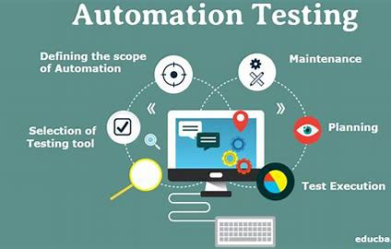
5.Integration and Testing:
Backend Integration: Ensure the backend system supports proximity-based queries and integrates seamlessly with your database of parking spots.
Testing: Thoroughly test the geolocation and proximity features across different devices and browsers to ensure accuracy and functionality.

Slide 7
Implementation Flow:
User Visits Website: The website prompts for access to the user’s location.
Location Detection: The geolocation API retrieves the user's coordinates.
Proximity Calculation: The backend computes distances to nearby parking slots and filters results.
Display Results: An interactive map updates to show the user’s location and nearby parking options.
User Interaction: Users can view details, book a spot, or get directions to the nearest parking slot.
Real-Time Updates: The website updates parking availability and user location in real time.
Benefits:
Enhanced User Experience: Simplifies finding nearby parking, increasing satisfaction.
Increased Engagement: Boosts usage rates and repeat visits.
Competitive Advantage: Differentiates your service with real-time, location-based information.

Slide 8
List of features offered by the solution
Urban Parking Management: Implement RFID, camera monitoring, and AR navigation to optimize urban parking spaces.
Traffic Reduction: Streamline parking processes to minimize search times and reduce traffic congestion.
Partnership Opportunities: Collaborate with MNCs and malls to enhance parking management and generate shared revenue.
Global Expansion: Leverage MNC networks for easy entry into international markets facing parking challenges.
Enhanced User Experience: Provide real-time parking updates and AR navigation for improved user convenience.
Sustainability Initiatives: Maximize existing parking space usage and reduce vehicle emissions through efficient parking solutions.

Slide 9
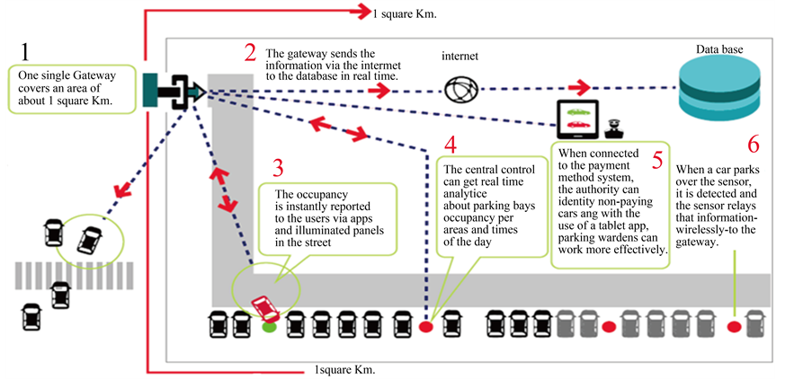
Architecture diagram of the proposed solution

Slide 10


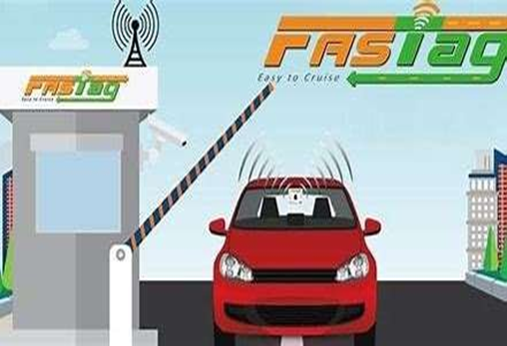
Technologies to be used in the solution
RFID Technology:
Fastag RFID tags for automated vehicle identification and access control.
Camera and Machine Learning:
High-resolution cameras paired with CNN algorithms to monitor parking slot availability.
Web Application:
Frontend: React for a responsive and dynamic user interface.
Backend: Node.js for handling authentication, data processing, and hardware integration.
Augmented Reality (AR):
ARCore and ARKit for providing virtual navigation maps and overlays.
Cloud Infrastructure:
AWS or Google Cloud for storage, computing services, and database management.
Security Measures:
SSL/TLS encryption for secure data transmission.
OAuth 2.0 for secure user authentication and authorization.
DevOps and Deployment:
CI/CD pipelines with Jenkins for automated testing and deployment.
Docker for containerization and Kubernetes for managing containerized applications and ensuring scalability.

Slide 11


Estimated implementation cost
Initial Development Costs:
App and Website Development: ₹5,00,000 to ₹15,00,000
Backend Infrastructure: ₹2,00,000 to ₹5,00,000
Design and User Interface: ₹1,00,000 to ₹3,00,000
Operational Costs:
Server and Hosting: ₹50,000 to ₹2,00,000 annually
Maintenance and Updates: ₹1,00,000 to ₹3,00,000 annually
Customer Support: ₹2,00,000 to ₹5,00,000 annually
Marketing and Promotion:
Digital Marketing: ₹2,00,000 to ₹10,00,000
Offline Marketing: ₹1,00,000 to ₹5,00,000
Legal and Compliance:
Licensing and Permits: ₹50,000 to ₹2,00,000
Legal Fees: ₹1,00,000 to ₹3,00,000
Miscellaneous Costs:
Office Space and Utilities: ₹2,00,000 to ₹5,00,000 annually
Miscellaneous Expenses: ₹1,00,000 to ₹3,00,000

Slide 12
Estimated price cost for User
Project offers a variety of parking services, including hourly, daily, weekly, and monthly plans. The cost can vary depending on the location and type of service you choose. Here are some general price estimates:
Hourly Parking: Typically ranges from ₹50 to ₹100.
Daily Parking: Usually around ₹200 to ₹500.
Weekly Parking: Approximately ₹1000 to ₹2000.
Monthly Parking: Can range from ₹3000 to ₹5000.

Slide 13
Master Plan
Phase 1: Research and Development (Months 1-6)
Phase 3: Full-Scale Launch (Year 2)
Feasibility Study: Research market demand and potential partners.
Expansion: Deploy across multiple Bangalore locations.
Technology Development: Create and test prototype parking solutions.
Marketing: Launch targeted marketing campaigns.
Prototype Testing: Gather feedback on prototype performance.
Support Setup: Establish customer support infrastructure.
Phase 2: Pilot Program (Months 7-12)
Phase 4: Expansion and Scaling (Year 3-4)
Site Selection: Choose pilot locations in Bangalore.
National Rollout: Expand to major Indian cities.
Partnerships: Secure agreements with MNCs, malls, and local businesses.
International Growth: Explore global market opportunities.
Refinement: Continuously improve system based on feedback.
Testing: Implement and evaluate system functionality.
Phase 5: Long-Term Growth (Year 5 and Beyond)
Diversification: Offer data analytics and sustainability features.
Leadership: Aim to become a global leader in smart parking solutions.
Innovation: Focus on technological advancements and strategic partnerships.

Slide 14


